Slide 1
Multilable classification on Reuters Newswire dataset
By Basavaraj Ingalagi

Slide 2
Approach to the problem
Tokenization
Stemming (Porter stem)
Removing stop words
TF-Idf vectorization
Multi label binarizer
One vs all
Micro & Macro averages

Slide 3
Tokenization
Tokenize returns a list of stems that appear in the text that was passed as an argument. Stop-words are ltered out, as well as words that are too short. Furthermore, any string that contains other than letters is removed (e.g., numbers).
Tokenize the document using nltk.word_tokenize()
After the tokenization the following sentence looks like this,
[ We ]
“We're moving to Bengaluru” [ 're ]
[ moving ]
[ to ]
[Bengaluru]

Slide 4
Stemming
“Stemming is process of reducing infected or derived words to their word stem, base or root form” –Wikipedia
Intelligence
Intelligently
Intelligent
Intelligen
Similarly {going ,go, gone} is stemmed to → go

Slide 5
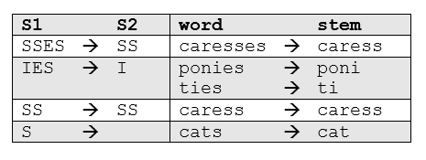
Porter stemmer
From a given set of stemming rules only one rule is applied, based on the longest suffix S1. Thus, caresses reduces to caress but not cares.
From a given set of stemming rules only one rule is applied, based on the longest suffix S1. Thus, caresses reduces to caress but not cares.
One of the most common - and effective - stemming tools is Porter's Algorithm developed by Martin Porter in 1980. The algorithm employs five phases of word reduction, each with its own set of mapping rules. In the first phase, simple suffix mapping rules are defined, such as:
From a given set of stemming rules only one rule is applied, based on the longest suffix S1. Thus, caresses reduces to caress but not cares.

Slide 6
Stop words
In natural language processing, useless words (data), are referred to as stop words.
Stop Words: A stop word is a commonly used word (such as “the”, “a”, “an”, “in”) that
Stop words are filtered from the text to be processed.

Slide 7
TF- Idf
TF= Term Frequency
IDF = Inverse Document Frequency
TF-TDF = TF * IDF

Slide 8
Vectorization(bag of words)
We can not work with text directly when using machine learning algorithms.
Instead we need to convert the text into numbers.
This done bag of words, and the matrix of number of occurrence of each word in a corpus is created.
Count vectorizer tokenizes the sentence & creates the count of occurrence of every word.
It is then fitted to the tain document
Followed by tf-idf transformer
Tf-idf tranformation assigns weights to each of the word in a document.

Slide 9
Example showing BOW
Word/doc | going | to | today | i | am | it | is | rain | not | outside
1 | 1 | 1 | 1 | 0 | 0 | 1 | 1 | 1 | 0 | 0
2 | 1 | 0 | 1 | 1 | 1 | 0 | 0 | 0 | 1 | 1
3 | 1 | 1 | 0 | 1 | 1 | 0 | 0 | 0 | 0 | 0
“It is going to rain today”
“Today I am not going outside”
“I am going to watch the movie”

Slide 10
Term frequency
(𝑁𝑢𝑚𝑏𝑒𝑟 𝑜𝑓 𝑜𝑐𝑐𝑢𝑟𝑟𝑒𝑛𝑐𝑒𝑠 𝑜𝑓 𝑎 𝑤𝑜𝑟𝑑 𝑖𝑛 𝑎 𝑑𝑜𝑐𝑢𝑚𝑒𝑛𝑡)
“to be or not to be”
(𝑁𝑢𝑚𝑏𝑒𝑟 𝑜𝑓 𝑤𝑜𝑟𝑑𝑠 𝑖𝑛 𝑡ℎ𝑎𝑡 𝑑𝑜𝑐𝑢𝑚𝑒𝑛𝑡)
To = 1+1
6
to = 0.33
be = 0.33
or = 0.16

Slide 11
Inverse document frequency
to = log(3/3)
log (
(𝑁𝑢𝑚𝑏𝑒r 𝑜𝑓𝑑𝑜𝑐𝑢𝑚𝑒𝑛𝑡𝑠)
(𝑁𝑢𝑚𝑏𝑒𝑟 𝑜𝑓 𝑑𝑜𝑐𝑢𝑚𝑒𝑛𝑡𝑠 𝑐𝑜𝑛𝑡𝑎𝑖𝑛𝑖𝑛𝑔 𝑤𝑜𝑟𝑑)
)
to = 0
be = 0
have = log(3/1)
“to be or not to be”
“i have to be”
“you got to be”

Slide 12
examples
“it is going to rain today”
“today i am not going outside”
“i am going to watch the movie”

Slide 13
Term frequency table.
words | Doc 1 | Doc 2 | Doc 3
going | 0.16 (1/6)
to | 0.16
today | 0.16
i | 0
am | 0
it | 0.16
is | 0.16
rain | 0.16
Sentence 1
It
Is
Going
To
Rain
Today

Slide 14
TF-IDF Model –Inverse Document Frequency
word | Idf value
going | log(3/3)
to | log(3/2)
today | log(3/2)
i | log(3/2)
am | log(3/2)
it | log(3/1)
is | log (3/1)
rain | log(3/1)
“it is going to rain today”
“today i am not going outside”
“i am going to watch the movie”

Slide 15
Tf idf matrix table
Words/ Doc | going | to | today | i | am | it | is | rain
Doc 1 | 0 | 0.07 | 0.07 | 0 | 0 | 0.17 | 0.17 | .0.17
Doc 2 | 0 | 0 | 0.07 | 0.07 | 0.07 | 0 | 0 | 0
Doc 3 | 0 | 0.05 | 0 | 0.05 | 0.05 | 0 | 0 | 0
𝑇𝐹-𝐼𝐷𝐹 𝑊𝑜𝑟𝑑 = 𝑇𝐹(𝐷𝑜𝑐𝑢𝑚𝑒𝑛𝑡,𝑊𝑜𝑟𝑑) ∗ 𝐼𝐷𝐹(𝑊𝑜𝑟𝑑)

Slide 16
Multilable binarizer
In a multilabel classification a text category can be assigned to more than one label.
The train and test labels have to be converted to the binary form before fitting it to the machine learning model.
This is can be done by the MultiLabelBinarizer
It is imported from sklearn.preprocessing and then fitted to the train and test labels.
Multilabel binarizer assigns 1 value to the labels wherever it belongs to the given text and it assigns zero value to the remaining labels.

Slide 17
Example
>>from sklearn.preprocessing import MultiLabelBinarizer
mlb = MultiLabelBinarizer()
mlb.fit_transform([(1, 2), (3,)])
Output : array([[1, 1, 0],
[0, 0, 1]])
>>mlb.classes_
Otput :array([1, 2, 3])

Slide 18
2nd example
>>>mlb.fit_transform([set(['sci-fi', 'thriller']), set(['comedy'])])
array([[0, 1, 1],
[1, 0, 0]])
>>>list(mlb.classes_)
['comedy', 'sci-fi', 'thriller']

Slide 19
One vs rest classifier
One-vs.-rest (or one-vs.-all, OvA or OvR, one-against-all, OAA) strategy involves training a single classifier per class, with the samples of that class as positive samples and all other samples as negatives. This strategy requires the base classifiers to produce a real-valued confidence score for its decision, rather than just a class label; discrete class labels alone can lead to ambiguities, where multiple classes are predicted for a single sample.

Slide 20
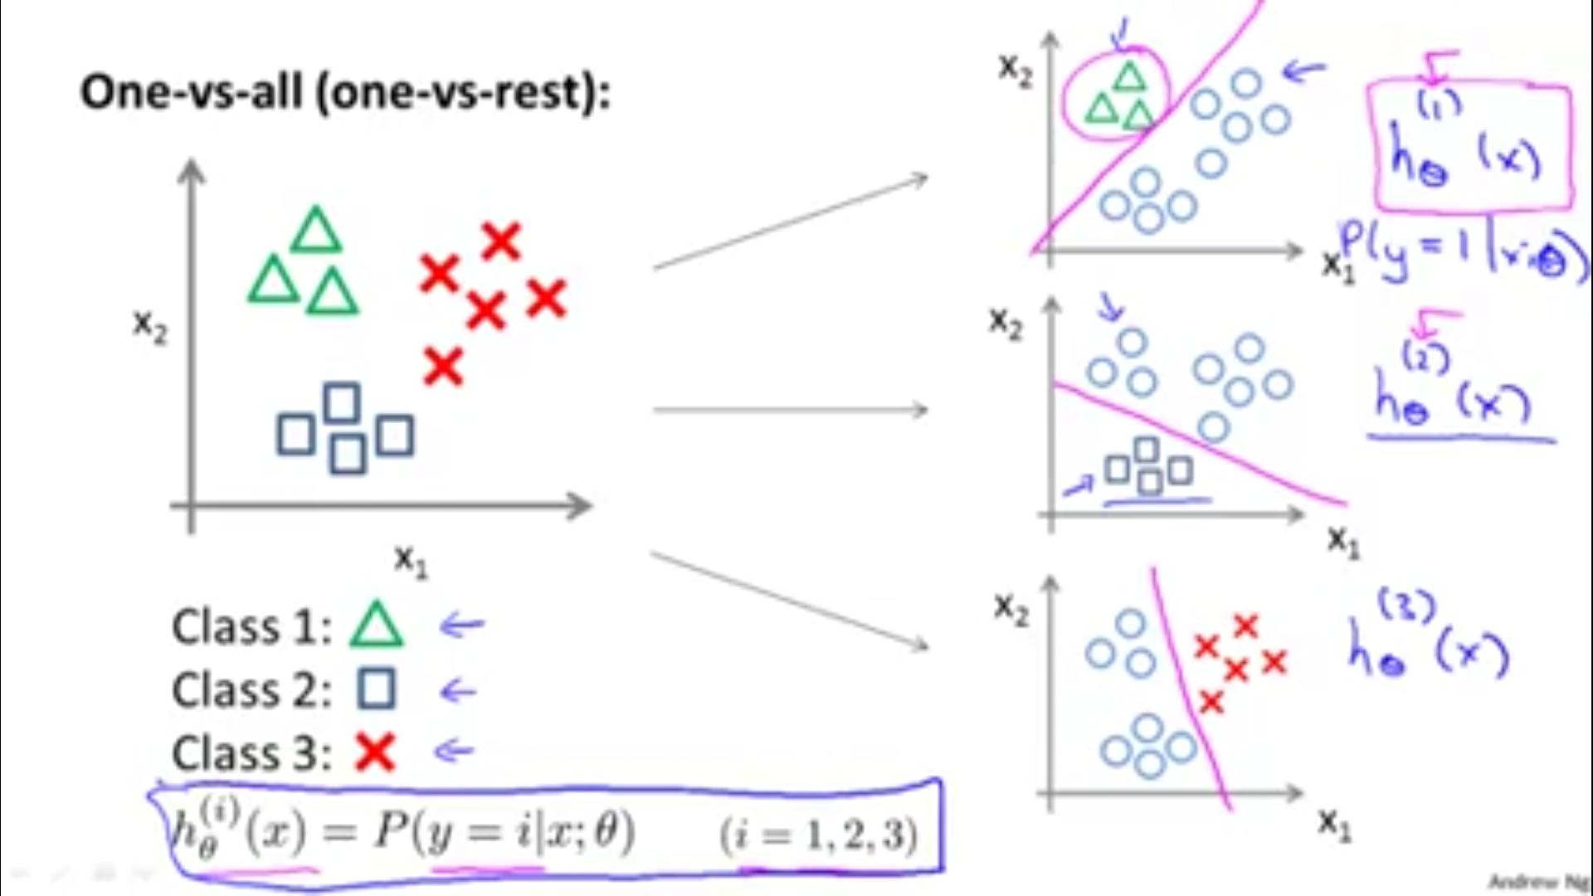
Illustration

Slide 21
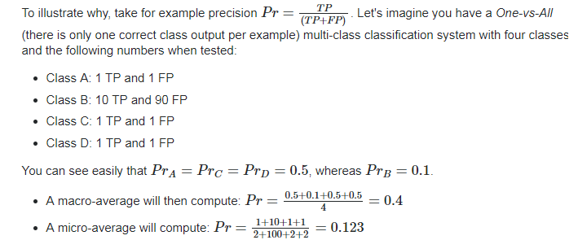
Micro and macro averages

Slide 22
Pickling the data set
t is used for serializing and de-serializing a Python object structure.
Any object in python can be pickled so that it can be saved on disk. What pickle does is that it “serialises” the object first before writing it to file.
Pickling is a way to convert a python object (list, dict, etc.) into a character stream. The idea is that this character stream contains all the information necessary to reconstruct the object in another python script.
So that if we once pickle and save the train model then next time we can directly load the trained model using pickle.load method and predict the result for new dataset or given unseen data.

Slide 23
Predicting the test or given data
During the prediction of new unseen data or test data we need to load the model first and then convert the text into tf idf transformation and then call model.predict method on tf-idf vecorised text document.
And assign it to a variable
For example :
prediction = model.predict(tfidf.transform(["text_file"]).toarray())
Here model is the variable name assigned to the trained machine learning model.

Slide 24

Conclusion

